Slide 1
Moles and Solutions -
Concentrations
Learning Objectives:
Calculate the amount of substance in moles, using solution volume and concentration
Describe a solution’s concentration using the terms concentrated and dilute.
Key Words:
Solution, solvent, solute, concentration, moles, volume, concentrated, dilute.

Slide 2
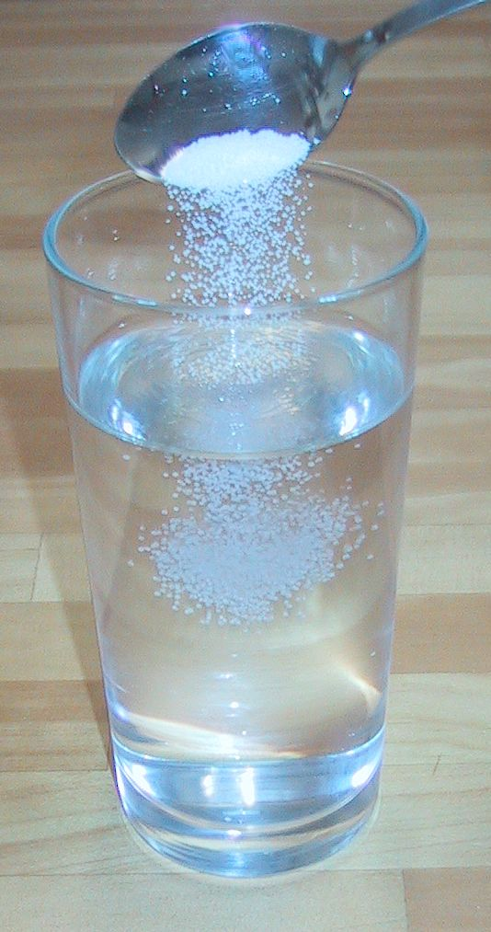
Concentration
In a solution the solute (e.g. salt/sugar) dissolves in the solvent (usually water).
For example in a solution of table salt the salt is the solute and water is the solvent.
The Resulting liquid is a solution of NaCl in water.
We can measure how much solute there is per unit volume of solvent to give a value for concentration

Slide 3
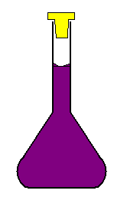
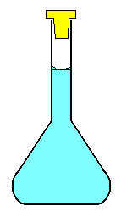
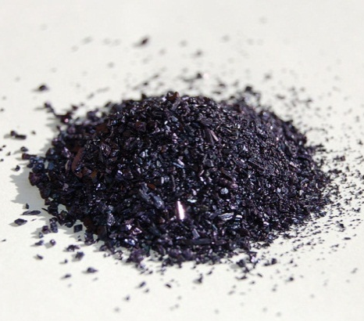
If we dissolve 158g of KMnO₄ in 1Litre of water we would make a solution of concentration 1mol L⁻¹
158g of KMnO₄
1 litre (dm³)
of water
Resulting solution contains 1 mole of KMnO₃ per dm³ of water
This is known as a 1 molar solution – 1M

Slide 4
If we take 250 cm³ if the solution we made how many moles of KMnO₃ are there in that sample?
250 cm³ of a 1M solution
1 dm³ of a 1M solution
Contains 0.25 moles
Therefore 39.5 g of KMnO₃
Resulting solution contains 1 mole of KMnO₃ per dm³ of water

Slide 5
How to Calculate
Concentration
If you know the concentration of a solution you can find the amount of substance in any volume of that solution.
n = c x V(in dm³) or c = _n_
v
n = no. of moles
c = concentration in mol dm⁻³
V = volume in dm³
If the volume you are given is in cm³ you will need to divide by 1000 to convert it to Litres or dm³.
How can you turn this into a formula triangle?

Slide 6
Standard Solutions
A standard solution has a known concentration. To do this…
Consider the volume of solution needed
Work out the amount, in mol, of solute needed
Convert this amount into mass, in g, so you know how much to weigh out.
For Example:
Find the mass of potassium hydroxide required to prepare 250 cm³ of a 0.2000 mol dm⁻³ solution

Slide 7
Concentrated or Dilute Solutions
The terms concentrated and dilute describe the relative amount of solute in a solution.
Concentrated – a lot of solute per dm³
Dilute – a small amount of solute per dm³
Normal lab bench solutions of acids have a concentration 1 or 2 mol dm⁻³ - these are dilute solutions.
Concentrated acids are solutions of above 10 mol dm⁻³

Slide 8
Questions
Find the amount, in moles, of solute dissolved in the following solutions;
a) 4 dm³ of a 2 mol dm⁻³ solution
b) 20.0 cm³ of a 0.150 mol dm⁻³ solution
c) 24.35 cm³ of a 0.125 mol dm⁻³ solution
2) Find the concentration, in mol dm⁻³ of the following solutions
a) 6 moles dissolved in 2 dm3 of water
b) 0.5000 moles dissolved in 250 cm³ of solution
c) 8.75 x 10 ⁻³ moles in 50.0 cm³ of solution.
3) Find the mass concentration, in g dm⁻³, in the following
(a) 0.42 moles of HNO₃ in 250 cm³ of solution
(b) 0.500 moles of HCl dissolved in 4 dm³ of solution
(c) 3.56 x 10 ⁻³ moles of H₂SO₄ dissolved in 25 cm³ of solution

