Slide 1
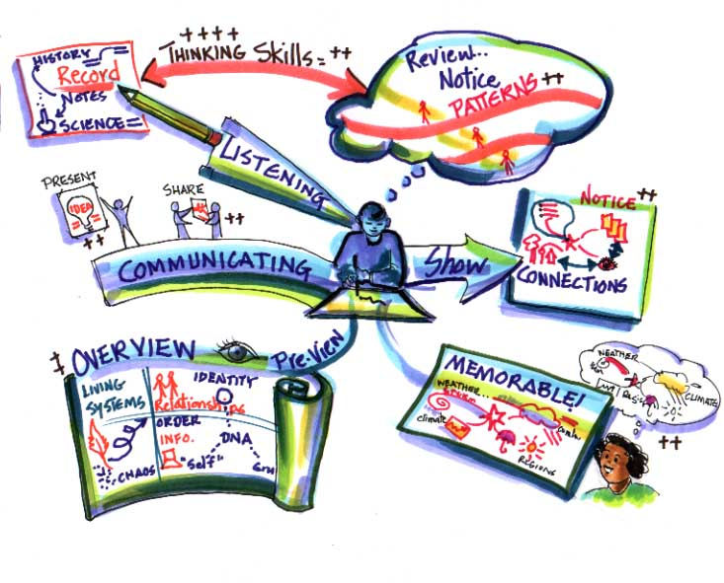
What does it mean to revise?
Learning information so that you can use it to answer questions.
Learning means that you have to understand something completely, remember it and eventually use it.
Depends how long it takes you to learn something - everyone is different.
BUT you have a lot to learn:
8-10 GCSEs;
10-15 exams;
2 years’ worth of work.
SO:
Start early - don’t cram!
Store knowledge in your long term memory;
Avoid panicking, stressing out, having a melt down and giving up!
When should I start revision?

Slide 2
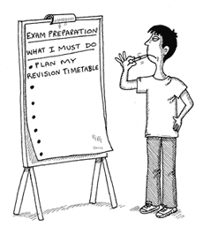
Do all your classwork, homework and coursework in term time to the best of your ability.
The more you do in school the less you have to do when you revise.
1 to 2 hours a day on homework or coursework.
Divide your revision time into bite size sessions.
25-30 minute episodes, with 5-10 minute breaks in between.
Vary it according to sort of knowledge you are learning and the way you are learning it.
If you don’t have 1-2 hours of homework to do every day (and even if you do!) you should start some revision in term time.
Start your revision slowly now and increase it nearer to the exams.
Use weekends;
3-4 hours over the course of the weekend during term time on homework, coursework and/or revision.
Some tips about timings for revision:
Some subjects take longer to revise than others.
Some subjects involve learning in different ways.
Create a revision timetable and stick to it:
Start to revise some of the older topics (from Year 10) now;
Some of you have retakes ;
If you start now, you can ask for help if you don’t understand something;
Do a revision timetable for the Easter holidays; if you leave all your revision to May half term, you will run out of time.
Use a calendar and factor in days out, sporting events, family time and socialising.

Slide 3
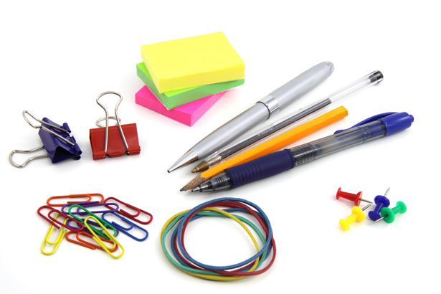
Get prepared:
You will feel better about revising if you have the right equipment
Pens and pencils; different colours;
Highlighters, felt pens;
A4 or A3 folders to store your class notes and revision notes;
Document or cardboard wallets;
Plastic wallets;
Exercise books or notepads;
File paper;
A5 or A6 Revision cards;
A3 or A4 plain or coloured paper;
Wall paper for timelines;
Post It notes;
Recording device (to play back)
Getting ready:
Get organised:
Make sure you know the following:
What knowledge and which skills you will need for each exam. If you do not know this, ask your teachers.
Which modules and topics you need to learn for each exam and subject. Most subjects will have given you a summary of topics or contents page.
Divide your revision into manageable sections; these could be modules, topics and sub topics.
Tick off the subtopics, topics and modules as you go through them and learn them.
Find out what exam board you are doing and use their website to access past papers, marks schemes and other helpful documents.

Slide 4
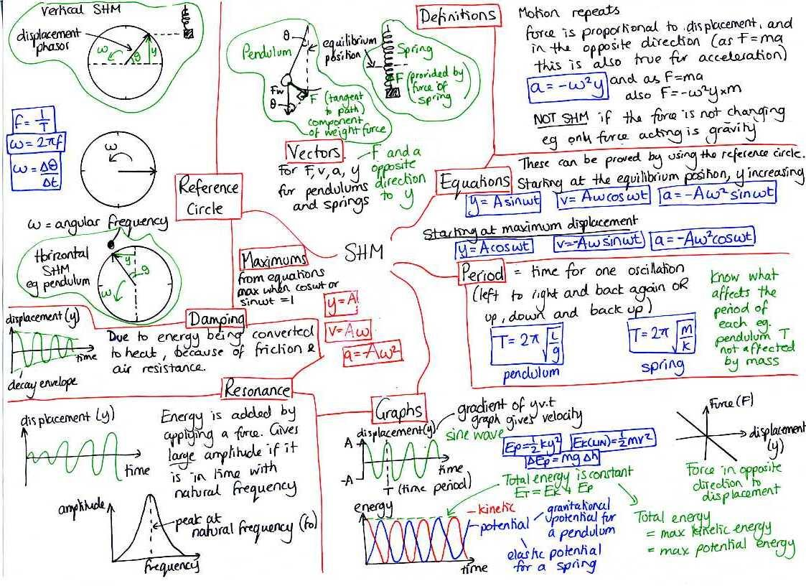
OK, so what is the basic idea behind revision?
Turn your classwork and information from textbooks into some form of revision notes and then learn them.
This means the following:
Revision needs to be active not passive; you actually have to engage with the process.
Reading through your folder and the textbook a few times will not do!
Reading revision guides will not do either; you will have been taught specifically for your exam board; revision guides tend to be quite general and so either contain too much information or too little. Only use guides that your teacher has suggested.
Remember that most exams will require you to write, so you will probably need to do
quite a bit of writing to revise for your exams.

Slide 5
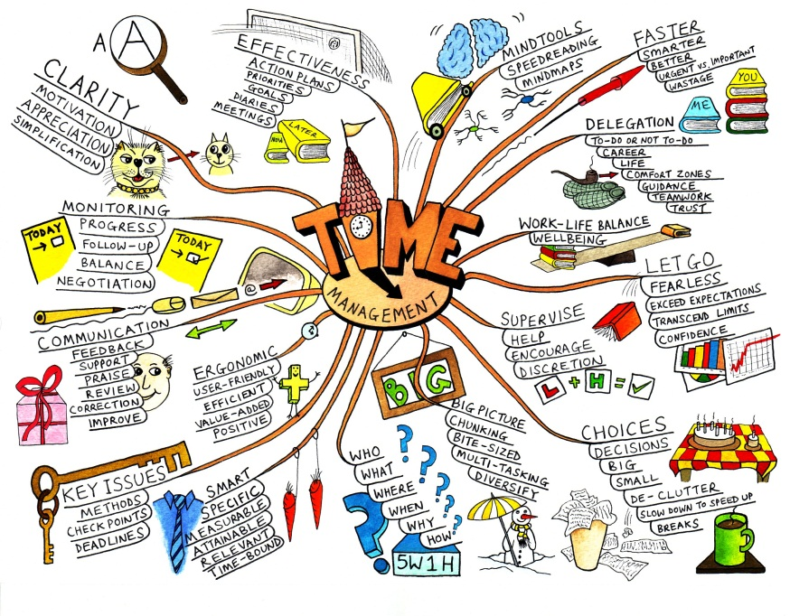
Some revision techniques:
Linear notes on paper:
Reduce what is in your folder/exercise book/textbook;
Read through what you need to summarise before you actually summarise it;
Use headings and subheadings
Keep notes brief;
Write everything in a way that you understand;
Do not copy huge chunks out;
Add detail
Underline key words; highlight; write in different coloured pens;
Use bullet points, arrows or numbers to keep it clear and organised;
Leave spaces to add points;
Use arrows or dotted lines to link points.
Mind maps or spider diagrams:
Key question, exam question or a key topic in the centre;
Subtopics or subheadings;
Add key pieces of information;
Develop some of your points;
Add symbols or images;
Use different coloured pens or highlight different points;
Use different sized pieces of paper.

Slide 6
Revision cards:
A5 or A6;
Key questions, headings or subheadings on each one and key information;
Lots of cards with different information, answering one question;
Move them around or stick them down on larger pieces or paper or around your room with blue tack.
Some revision techniques:
Drawing memory anchors or picture based notes:
Combination of key words, numbers and pictures;
Create a key;
Use a combination of notes and pictures.
Post it notes:
Definitions;
Bullet point the answer to key questions;
Different post it notes, each containing different parts of an answer to one question;
Can be moved around, linked or prioritised.

Slide 7
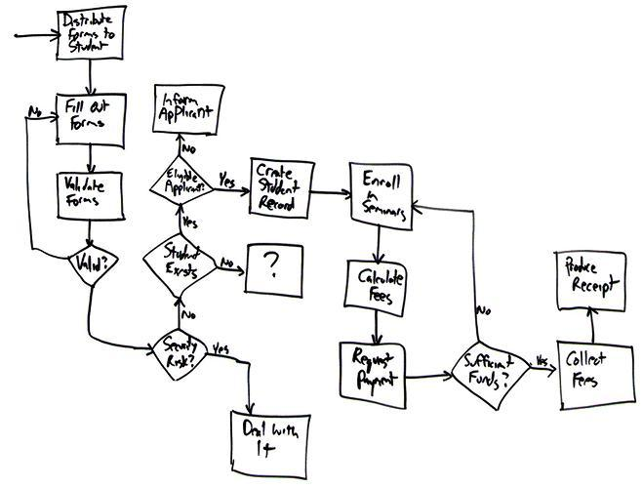
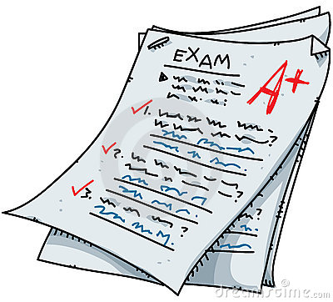
Some revision techniques:
Plenty or exam papers and questions:
Revise a topic and attempt an exam paper;
Use the questions as headings and subheadings for revision notes, mind maps and cards;
Get your head round the skills needed for each question;
Recognise the question types;
Apply formulas you have learnt (especially for science and maths);
Make a note of the question you have no idea about.
Flow charts or timelines:
Large pieces of paper (rolls of wall paper or pieces stuck together);
Key dates, ideas, processes or stages;
Add the information as you go along;
Use different coloured pens or highlighters;
Add images or diagrams.

Slide 8
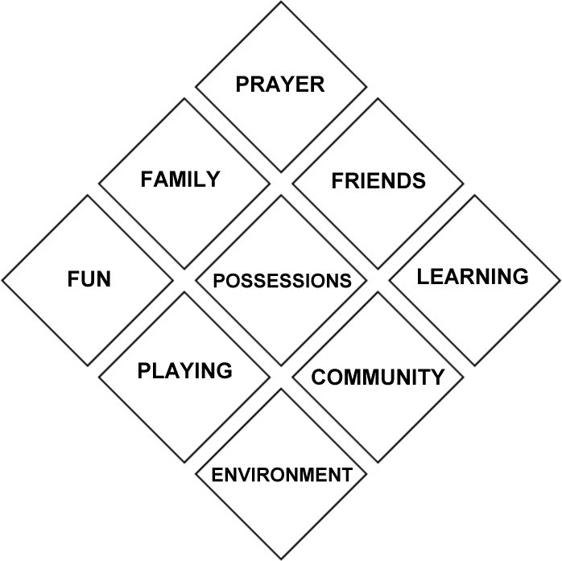
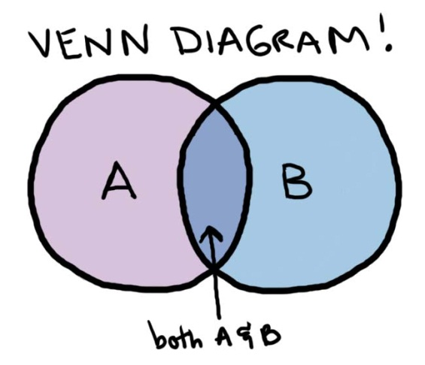
Other techniques:
Songs; poems or raps!
Mnemonics (devices to help you remember numbers and words);
Quizzes;
Question and answers;
Read, cover, up, say, write, check;
Role play;
Teach somebody else;
Read, summarise (write), record (speak) on recording devise and play back (listen).
Colour code text picking out different points each time;
Create Venn diagrams or diamond 9 shapes.
Some revision techniques:
Other resources:
If you have worked throughout the course of your GCSEs your folder/exercise book and any textbook your teacher recommends should be more than enough to revise and get top marks. You can however also use additional resources:
Getrevising.co.uk (you can make flashcards and revision notes and it tests you interactively);
U2learn.com (gives you links to all the key subject based websites that have handy revision material, like GCSE bite size).

Slide 9
Avoid all distractions:.
Be honest and strict with yourself;
Keep your TV, computer, laptop, ipad, phone, kindle, Facebook, twitter and any games away
If music becomes a distraction, get rid of it.
Do not waste time or delay starting.
Clear space to store folders, textbooks and revision.
It is going to be around for a while so make space for it somewhere in your house. Make sure you tell parents what it is and where it is so they do not move it or throw it out!
In your breaks:
move around;
drink water;
eat something .
You will need a desk or a table that is not cluttered so you can spread things out on. You might want to leave things out for the next session.
Sleep well:
Do not work into the early hours of the morning
give yourself a break between finishing revision and going to bed.
Some final tips to help you when revising:
Do some form of exercise during
revision and exams.
Reward yourself at the end of your revision session.
Find a space you are comfortable revising in:
This might be your bedroom, or a study or the kitchen. Some of you might find it easier to revise if your parents are there with you.
Tell your parents/family or who you live with when you are revising:
They can help by keeping distractions away from you including themselves, brothers, sisters, friends and pets and keeping the house quiet.
They can help and support you by testing you and keeping you on track if you lose focus.

Slide 10
Remember why you are doing this:
If you have not already worked this out, you are doing all of this for you!
Set yourself a target and go for it.
Success in exams is not the be all and end all in life BUT IT DOES HELP!
Exams do mean grades and good grades mean a better chance of a good job or further and higher education, a career and opportunities.
Do not throw opportunities away because you are too lazy or impatient for the summer to begin.
GCSEs are not impossible; they are designed for most people to do well in.

