Slide 1
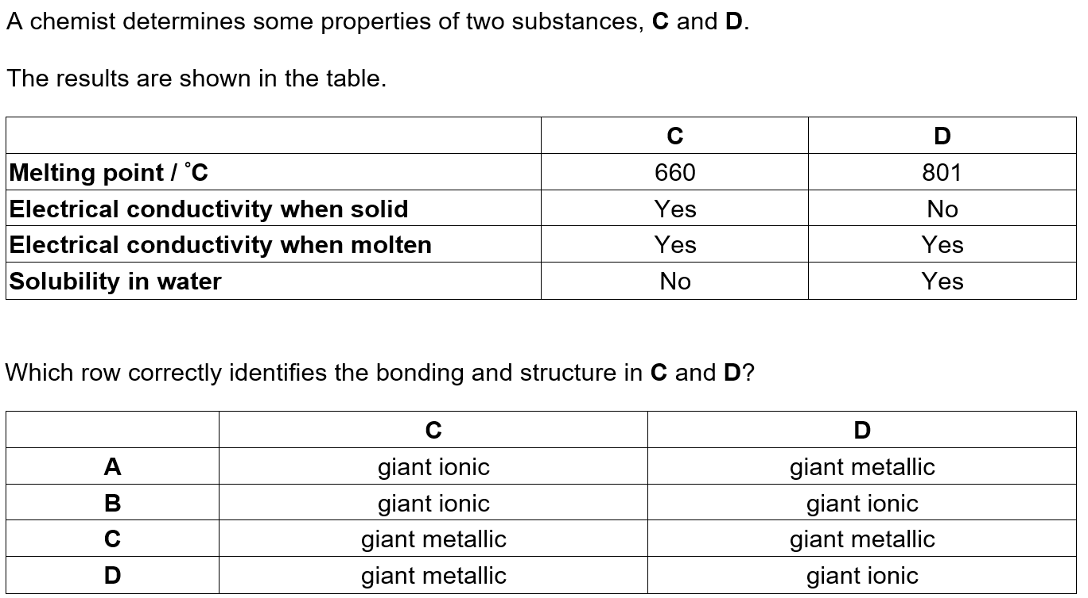

Slide 2
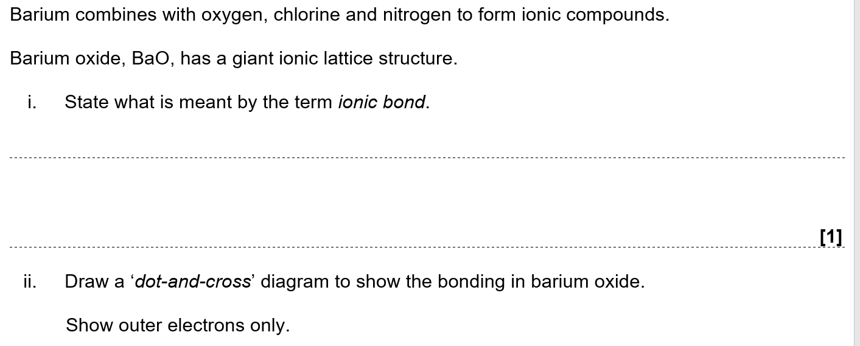
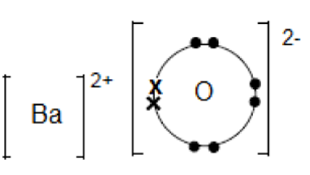
Electrostatic attraction between positive and negative ions

Slide 3
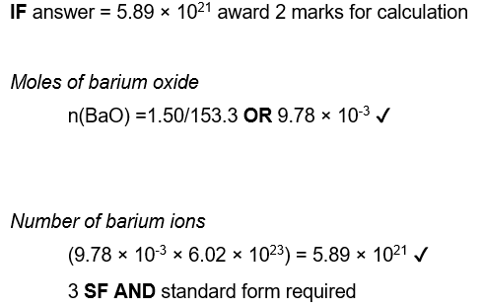
Mr Ba0 = 153.3 gmol⁻¹

Slide 4
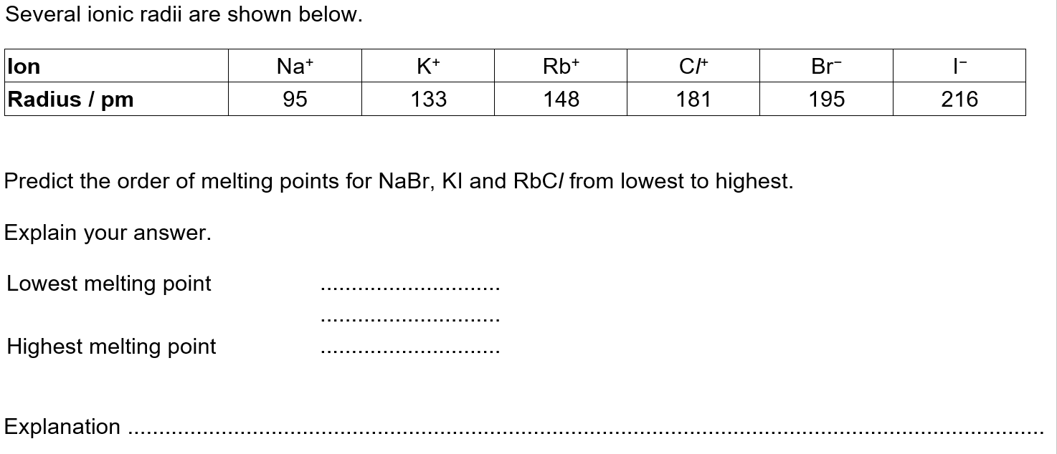

Slide 7
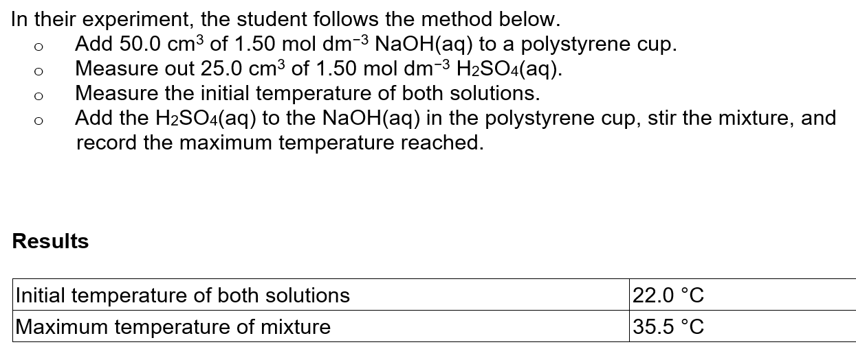
q = m x C x ΔT
q = mass (of water) x C (4.18) x ΔT (35.5-22.0)
q = 75 x 4.18 x 13.5 =4232.25 J = 4.23225 kJ
Moles NaOH = 1.50x 50.0/ 1000 = 0.075 mol
Δ_{neut}H = energy release per mol
Δ_{neut}H = 4.23225/0.075 = -56.43 kJ mol⁻¹

